Slide 1

Software Engineering CS-UH 2012, SPRING 2025
Midterm Review
Dr. Mohamad Kassab, m.kassab@nyu.edu

Slide 2




Guidance to the Midterm exam

Slide 3

Software Development Life Cycles

Slide 4


Software development processes
Waterfall
Rapid Prototyping
Agile (Scrum)
What are the roles of SCRUM team?
The customer keeps making changes to the requirements, even during the design and development phases. What approach could you have employed (could employ) to try to mitigate this problem?
Notes:
You are chief engineer for a safety critical system that is being custom-built for a long-time customer. The customer keeps making changes to the requirements, even during the design and development phases. What approach could you have employed (could employ) to try to mitigate this problem?
Employ a new non- agile development methodology.
Reduce communications with the customer to minimize disagreements.
Have a customer representative at the vendor site at all times.
Increase charges to the customer for every requirements change.

Slide 5

Requirements engineering

Slide 6
Requirements engineering
Elicitation Techniques
Requirements Documentation
Functional Requirements vs. Non-Functional Requirements.
Requirements Qualities

Slide 7
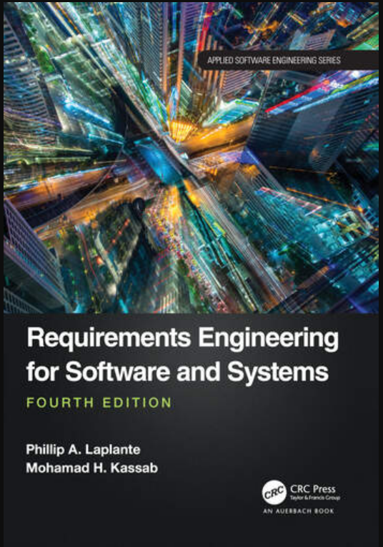
Elicitation Techniques
Requirements Elicitation Techniques
Chapter 3 of Requirements engineering for software and systems MANDATORY reading^{PDF WILL BE POSTED}
Brainstorming *
Card Sorting *
Crowd Sourcing
Designer as Apprentice
Domain Analysis
Ethnographic Observation *
Goal Based Approaches
Group Work *
Interviews *
Introspection *
Joint Application Design
Laddering *
Protocol Analysis
Prototyping
Quality Function Deployment (encompasses card sorting and laddering and domain analysis)
Questionnaires *
Repertory Grids
Reverse Engineering
Task Analysis
Scenarios & Use Cases
User Stories
Viewpoints *
Workshops
Notes:
Crowd Sourcing Distributed input, large sample, online-oriented Gathering diverse opinions; collecting large-scale preferences
Joint Application Design (JAD) Structured workshop, think offsite. Requirements clarification; reconciling multiple viewpoints quickly
Protocol Analysis Relevant to automating tasks. Walk with customer through which procedures will be automated.
Quality Function Deployment (QFD) Structured matrix, links needs to specs Aligning features with customer priorities; managing product quality Repertory Grids Matrix of features and desirable qualities of the system with scores for each combination. Multiple people scoring
Reverse Engineering Very useful in migrating old projects or copying someone else’s
Task Analysis Start at high level and break down higher level tasks to lower level ones.
Scenarios & Use Cases Requirements as narrative/stories
User Stories Simple, Agile-oriented, role-action-value Capturing functional needs from user perspective

Slide 8
IEEE Std 29148
Describes standard for, system engineering including quality requirements
For a single requirement
Singular
Feasible
Unambiguous
Complete
Consistent
Verifiable
Traceable

Slide 9
IEEE Std 29148
For a set of requirements
Complete
Consistent
Bounded
Affordable

Slide 10
Singular
Each requirement specifies a single and have no conjunctions.
3.1.1 The pump control unit shall start the submersible pump motors to prevent the wet well from running over and stop the pump motors before the wet well runs dry.
versus:
3.1.1.1 The pump control unit shall start the submersible pump motors to prevent the wet well from running over.
3.1.1.2 The pump control unit shall stop the pump motors before the wet well runs dry.
Conjunctions can be used if they describe a single behavior
3.2.6 The light emitted by the display shall be either red or yellow.

Slide 11
Feasible
A requirement that can be satisfied with current technology and cost constraints,
Not a ridiculous requirement.
Examples
The system shall consume no power.
The length of the beam shall be less than 0 feet.

Slide 12
Unambiguous
A requirement is unambiguous if it can have only one interpretation.
Example
If the valve is open and the drain is open, then it should be closed.
Conjunctions can cause ambiguity and that is why they should be avoided.

Slide 13
Complete
A requirement is complete “to the extent that all of its parts are present and each part is fully developed.”
Switch 1 shall have two positions, one position is “on”.
Same property for a set of requirements
E.g. no “TBD”

Slide 14
Consistent
A requirement is consistent if it does not contradict itself (internal) or a prevailing standard or law (external).
If the lever is in position 1 then it shall open and close the valve.
Same for a set of requirements (e.g.)
3.1 If the lever is in position 1, then valve 1 is opened.
3.2 If the lever is in position 1, then valve 1 is closed.

Slide 15
Verifiable
Satisfaction of the requirement can be demonstrated
The system shall be user friendly
Usually needs metrics associated with the requirement
Important to always envision the acceptance test along with the requirement
Goal-question-metric paradigm useful

Slide 16
Traceable
Numbered or indexed somehow
Essential quality for effective communications ease of modification, and legal considerations.
Stored in a requirements management tool

Slide 17
Bounded
A set of requirements is bounded if it does not exceed the scope of the system intent.
Important to avoid scope creep.
Refer to mission statement (or conops) to avoid scope creep;
e.g. does this requirement fit the mission?

Slide 18
Affordable
For a set of requirements meets budgetary constraints.
Affordability analysis discussed later

Slide 19
Ranked
Not a 29148 mandated quality, but…
Important for design decisions, tradeoff analysis, budget negotiations and more
Rank can be ordinal (1, 2, 3, …) or subjective (high, medium, low), or based on need (mandatory, desirable, optional)
Two requirements can hold the same rank
Ranking is part of the requirements agreement process

Slide 20

Writing Requirements as Use Cases

Slide 21
Useful Use Case Guidelines
Complete Single Goal
Leveled Steps
Technology Neutral
Scenario Plus Fragments
Exhaustive Alternatives
Common Sub Behavior
Interrupts As Extensions
Notes:
Explained on upcoming slides

Slide 22

Software Design

Slide 23

Object Oriented Design
Use Cases → System Sequence Diagrams → Domain Model → Operation Contract → Interaction Diagram → Class Diagram

Slide 24
Use Case Example: Withdraw from ATM
Scenario 1 (Main Success Scenario): Standard Withdrawal
User inserts their ATM card into the machine.
ATM prompts the user to enter their PIN.
User enters the correct PIN.
ATM displays the main menu, and the user selects "Withdrawal" option.
User specifies the amount to withdraw.
ATM checks the account balance and ensures sufficient funds are available.
If funds are available, ATM dispenses the requested amount in cash.
ATM updates the account balance and prints a receipt.
User retrieves the cash and the receipt.

Slide 25
SSD Example: Register for Courses
Notes:
System as a black box – the underline and : represent that it is an instance.
3 messages sent to the system
Student can select semester list and course list several time.
System sends bill request message to billing system class
Notice the activation bars – system active when it gets request from student.

Slide 26
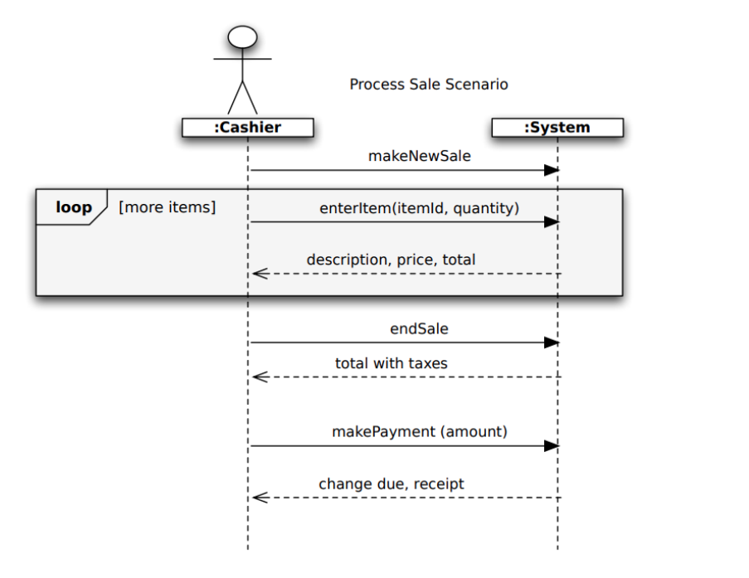
SSD EXAMPLE

Slide 27
Hoes does a Domain Model Looks Like?
Records-sale-of
Described-by
1
Product
Product
Catalog
Contains
Specification
1
1..
*
description
price
1
UPC
Association
0..1
*
Used-by
Describes
Sales
*
*
LineItem
Store
Stocks
Item
quantity
1
address
1
*
1
1..
*
name
Concepts
Contained-in
Logs-
1
Houses
1
completed
1..
*
6
Sale
*
register
date
Started-by
Manager
Captured-on
1
1
time
1
Paid-by
1
1
Initiated-by
1
Records-sales-on
Attributes
1
1
1
Payment
Customer
Cashier
amount

Slide 28
Special Considerations for Associations
Generalizations
Association Classes
Aggregation and Composition

Slide 29
Generalization
One type of association is Generalization. This type aims to organize concepts to identify commonality among them.)
The superclass of payment and the subclasses of cash payment, credit payment, check payment
Payment
This is how we represent Generalization in UML
Cash Payment
Credit Payment
Check Payment

Slide 30
Association Classes
Let's consider an example using a "Person" and "Company" scenario”.
Assume you have a system where individuals can be employed by multiple companies, and for each employment, there is additional information such as the role or position and the start date.
In this case, you can use an association class to represent the relationship between "Person" and "Company" with the added information about the employment.
Employs 0..* *
Person
Company
Employment
Notes:
We can see from the diagram that a Person may work for a single Company. We need to keep information about the period of time that each employee works for each Company.
We can do this by adding a dateRange attribute to the association. We could add this attribute to the Person class, but it is really a fact about a Person's relationship to a Company, which will change should the person's employer change.

Slide 31
Aggregation
It is a kind of association used for modeling whole-part relationships
Shown in UML as a hollow diamond symbol at the “whole end” of the whole-part association
No semantic difference to a regular association, which is why Larman avoids it.

Slide 32
Composition
It is a specialized form of aggregation
Shown in UML as a filled diamond symbol at the “whole end” of the whole-part association
More meaningful than aggregation.
The parts are “owned” by the whole…they are often created together, they definitely die together, and operations applied to the whole propagate to the parts.

Slide 33
System Operation Contracts
Notes:
Operation contractions use a pre and post condition form to describe detailed changes to objects in a domain model
To create a contract – identify the system operations from the system sequence diagram

Slide 34
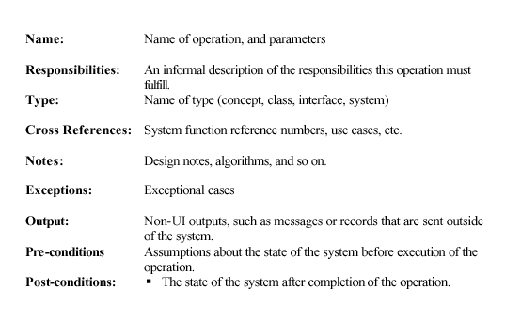
Operation Contract Full Template

Slide 35
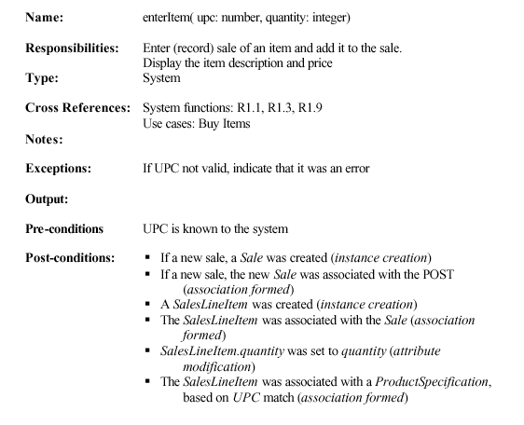
Example (Operation Contract for enterItem)

Slide 37
GRASP Patterns
Expert
Creator
Controller
Low Coupling/High Cohesion
Polymorphism
Pure Fabrication
Indirection
Don’t Talk to Strangers (Law of Demeter)

Slide 38

INTERACTION DIAGRAMS
SYSTEM SEQUENCE DIAGRAMS
SEQUENCE DIAGRAMS
COMMUNICATION (COLLABORATION) DIAGRAMS
DOMAIN
MODEL

Slide 39
How to Make a Class Diagram
1. Identify all the classes participating in the software solution by analyzing the interaction diagrams. The interaction diagrams is your starting point.
Draw them in a class diagram
2. Duplicate the attributes from the associated concepts in the domain model.
3. Add method names by analyzing interaction diagrams
4. Add type information to attributes and methods
5. Add associations necessary to support required attribute visibility
6. Add navigability to associations to indicate direction of visibility
Notes:
UP does not define an artifact called “design class diagram”
In the design model – several diagram types exist: interaction, package, classdiagrams
We will go over how to do each in the next few slides

Slide 40
From Communication diagram
To Class diagram
Notes:
Navigability is a property of the role that indicates that it is possible to navigate uni-directionally across the association from objects of the source to target class. Navigability implies visibility.
Could have put currentSale: Sale to show the current Sale attribute. It was excluded because it is implied by the navigable association from Register to Sale.

Slide 41
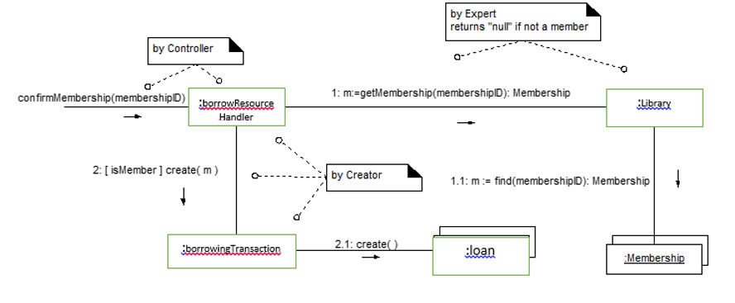

Slide 42

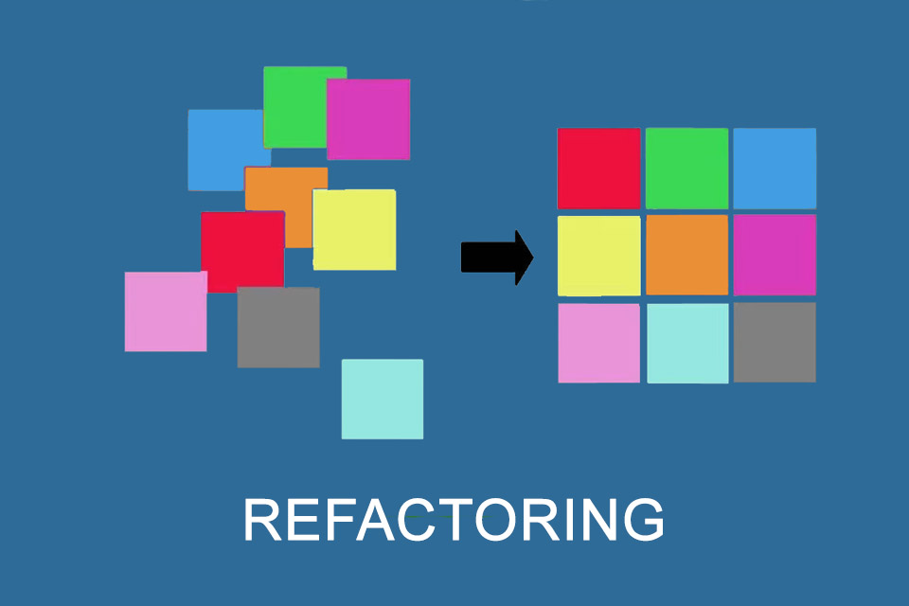
SOFTWARE CONSTRUCTION

